Slide 1

Using Excel’s power query for data transformation

Slide 2

Power Query
Power Query is a data connectivity and data transformation tool in Excel that allows users to extract, transform, and load (ETL) data from various sources. It simplifies the process of cleaning and reshaping large datasets without needing complex formulas or VBA. Power Query is particularly useful for automating the import and preparation of data for analysis in Excel or Power BI.

Slide 3

Key Features of Power Query
Data Connectivity:
Power Query supports importing data from a wide range of sources, such as Excel workbooks, databases (SQL Server, MySQL), cloud services, web pages, CSV files, and more.
Data Connectivity:
Power Query supports importing data from a wide range of sources, such as Excel workbooks, databases (SQL Server, MySQL), cloud services, web pages, CSV files, and more.
Automating Data Processes:
Power Query automates repetitive tasks. Once you've designed a query, you can refresh it anytime to update your data without reapplying transformations.

Slide 4
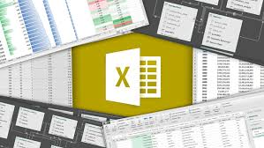
Key Features of Power Query
User-Friendly Interface:
Power Query provides an intuitive, step-by-step interface where each transformation applied to the data is recorded as a step in the "Applied Steps" pane. Users can review, edit, or delete these steps.
Query Editor:
Power Query uses a Query Editor where users can interact with their data before loading it into Excel. In this editor, users can: Filter and sort data.
Integration with Power BI:
Power Query is also used in Power BI for similar ETL purposes. If you're familiar with Power Query in Excel, the transition to Power BI is seamless.

Slide 5
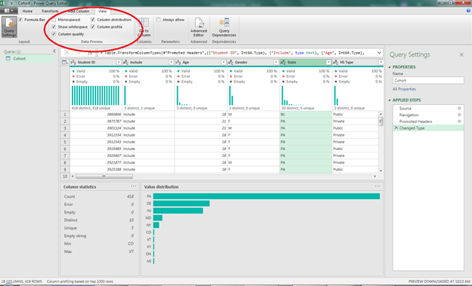
Common use cases for Power Query
Combining Data from Multiple Sources:
For example, you might want to pull sales data from various regions stored in separate Excel files and combine them into one table.
Cleaning and Shaping Data:
It helps transform messy data (e.g., dealing with different formats, removing nulls, or consolidating information from multiple sheets).
Appending Data:
You can add new data (e.g., monthly sales records) to existing datasets, ensuring a smooth process for regularly updated reports.

Slide 6
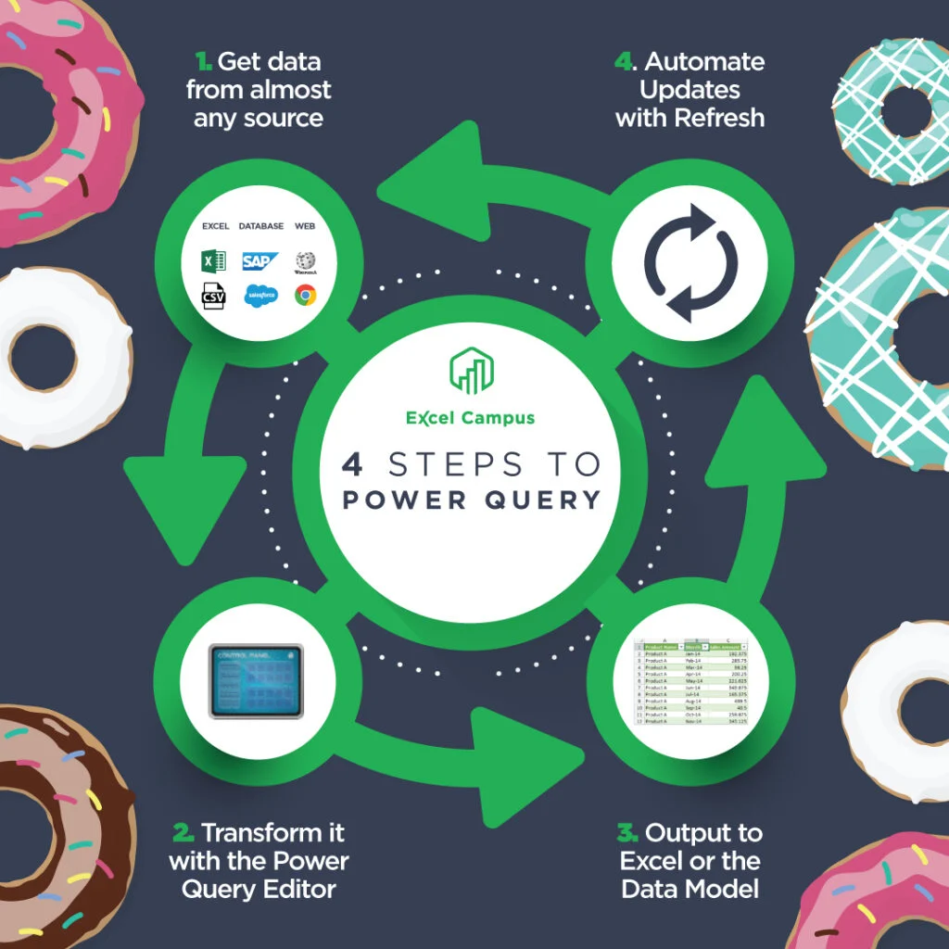
Merging Tables:
You can combine related data from different tables (e.g., matching customer data from one source with order details from another).
Web Data Scraping:
Power Query can extract data from websites. For instance, you can pull currency exchange rates or stock prices from a webpage into your Excel file and refresh it periodically

Slide 7
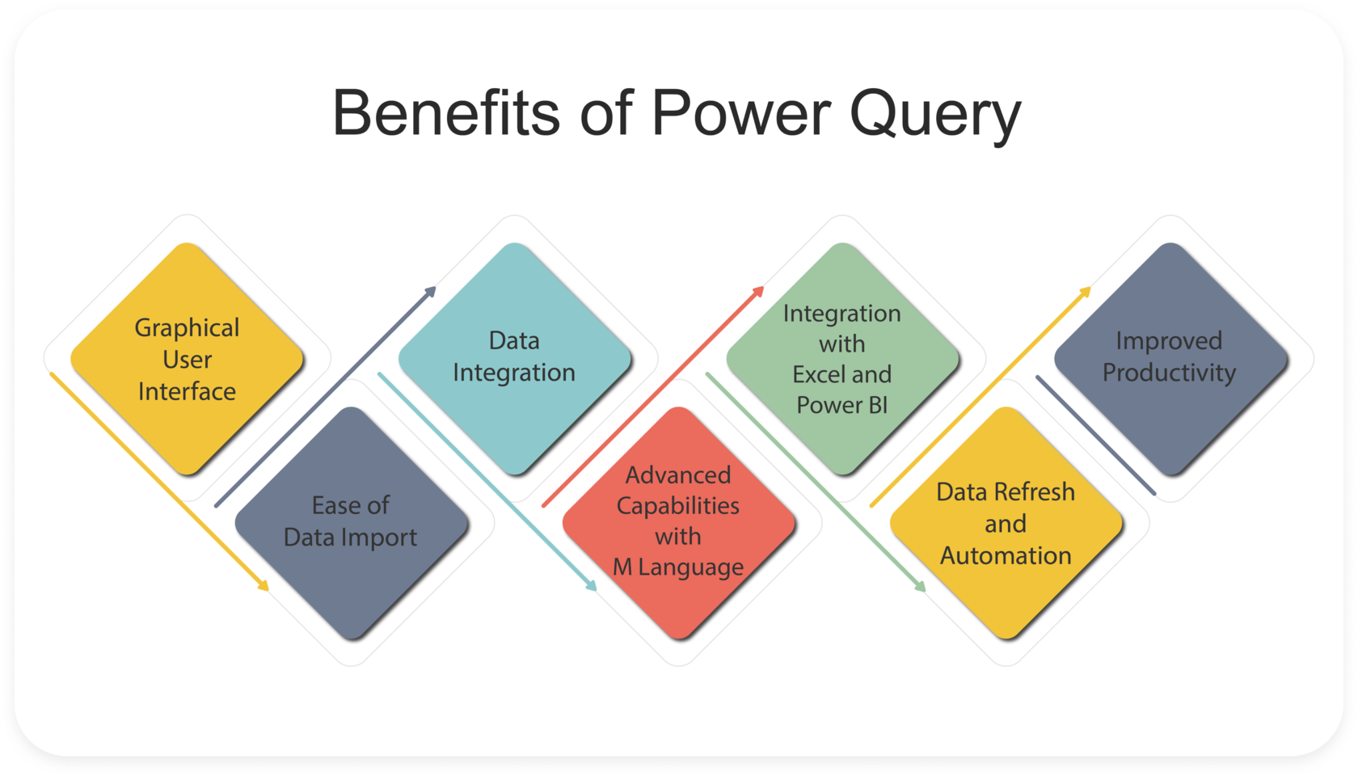
Benefits of using Power Query
Time-Saving: It automates repetitive data preparation tasks, so you can refresh data with a single click.
No Coding Required: Power Query's visual interface makes it accessible to users who don't know how to code.
Powerful Data Cleaning: It handles large, messy datasets and prepares them for analysis with ease.
Scalable: Power Query can process large datasets and combine multiple sources efficiently.

Slide 8

Conclusion
In summary, Power Query in Excel is a powerful ETL tool that helps users connect to multiple data sources, clean and transform data, and automate workflows—all without needing complex formulas or programming knowledge. It’s an essential feature for anyone working with large amounts of data in Excel.

Slide 9


Thank you
ajaycraju98@gmail.com

